Slide 1
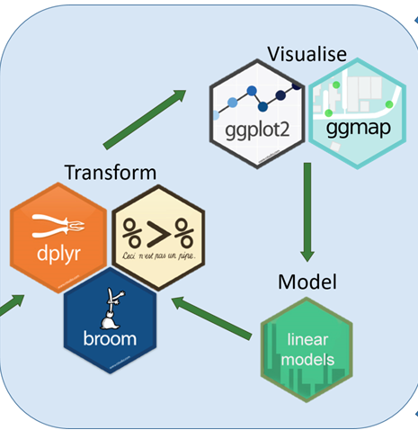
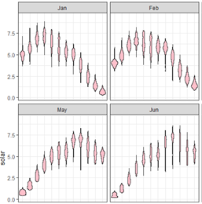
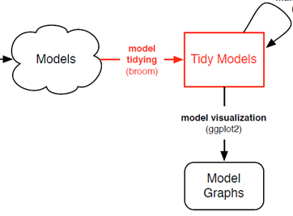

ggplot2: Going further in the tidyverse
Michael Friendly
Psych 6135
https://friendly.github.io/6135/

Slide 2
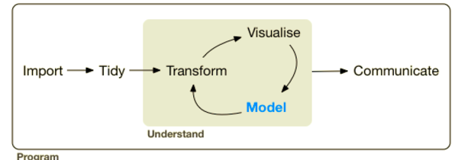
A larger view: Data science
Data science treats statistics & data visualization as parts of a larger process
Data import: text files, data bases, web scraping, …
Data cleaning → “tidy data”
Model building & visualization
Reproducible report writing

Slide 3

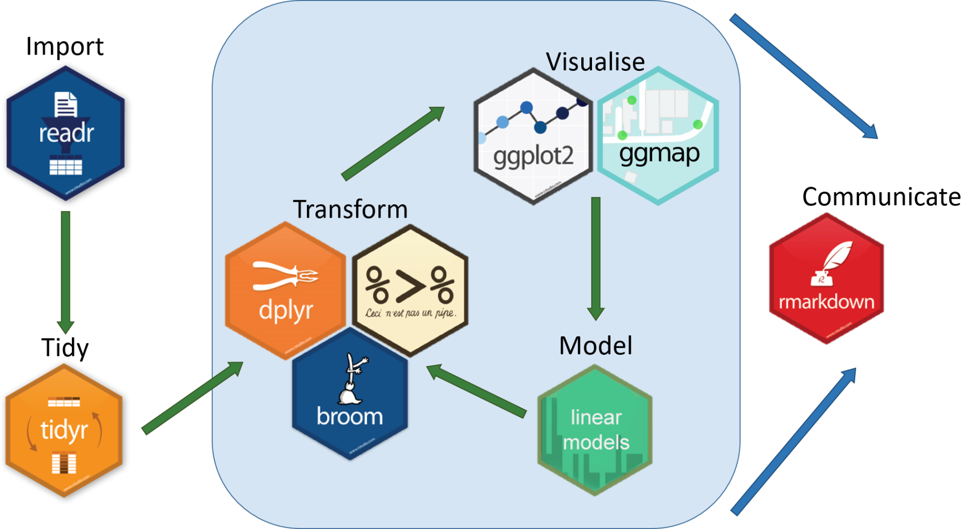
The tidyverse of R packages

Slide 4

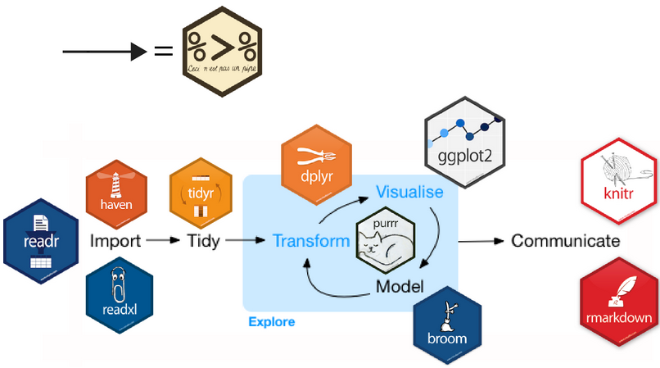




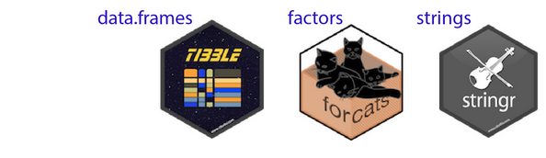



The tidyverse expands
dates

Slide 5

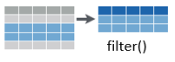
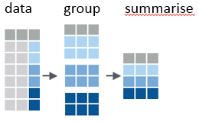




Topics for today
Data import / export
Data wrangling: getting your data into shape
dplyr & tidyr
pipes: %>%, now: |>
grouping & summarizing
Example: NASA data on solar radiation
Working with models: broom
Example: gapminder data
Nice tables in R
Writing & publishing

Slide 6
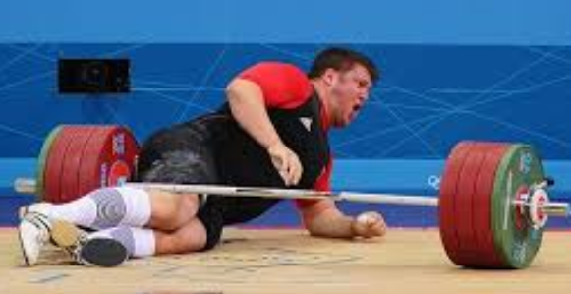
Ready for some heavy lifting?
New ideas, ways of thinking & working are on the table!

Slide 7



Data Import / Export
The readr package is the modern, tidy way to import and export data
Tabular data:
comma delimited (read.csv)
any other delimiters (“;” = read.csv2; <tab> = read_tsv)
Data types:
specify column types or let functions guess
Other data formats
package | Data types
haven | SAS, SPSS, Stata
readxl | Excel files (.xls and xlsx)
DBI | Databases (SQL, …)
rvest | HTML (web scraping)

Slide 8
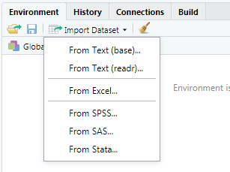
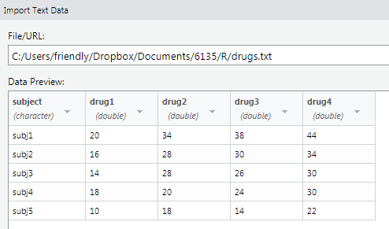
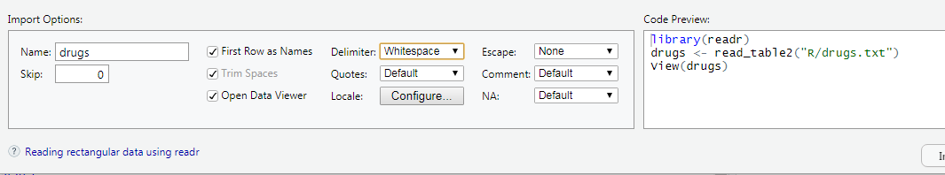
Data Import: RStudio
file:
options:
code:
copy code to your script

Slide 9




Data transformation tools
Some common data types can be messy when imported. Tidy tools are there to help
dates/times | lubridate | read dates/times in various formats; extract components
factors | forcats | Change order of levels, drop levels, combine levels
strings | stringr glue | detect matches, subset, replace interpolate values into strings
Clean-up | janitor | Clean up variable names, find duplicate records

Slide 10
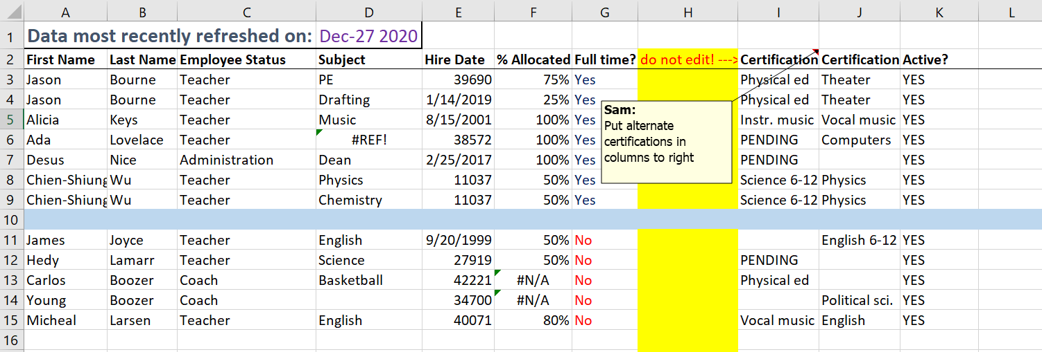
Janitor
Unwanted header
Possibly duplicated rows
Illegal variable names
Rows / cols with no data
Weird dates
library(janitor)
Data <- read_excel(dirty.xlsx) |> clean_names() |> remove_empty() |> …
Documentation: https://sfirke.github.io/janitor/

Slide 11
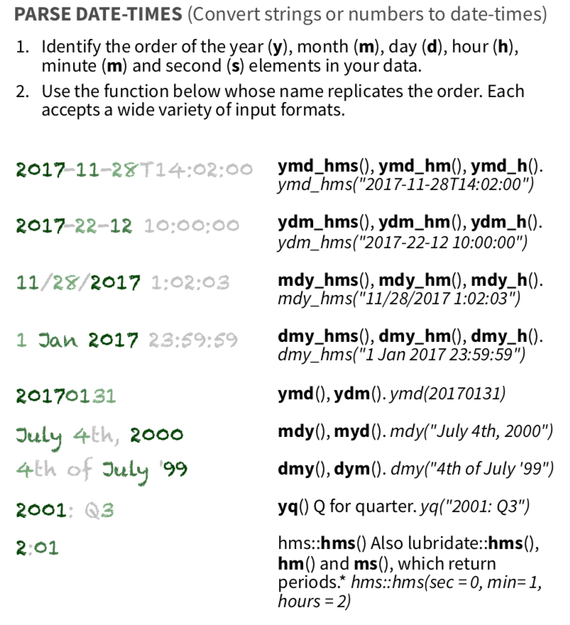
lubridate: Dates & times
Dates & times come in so many forms!
# parse dates in various formats
ymd("20210604")
#> [1] "2021-06-04"
mdy("06-04-2021")
#> [1] "2021-06-04"
dmy("04/06/2021")
#> [1] "2021-06-04"
# extract date components
minard_bday <- ymd("1781-03-27")
year(minard_bday)
#> [1] 1781
month.name[month(minard_bday)]
#> [1] "March"
# date arithmetic: how old is Minard?
year(today()) - year(minard_bday)
#> [1] 244
Learn more at: http://lubridate.tidyverse.org

Slide 12
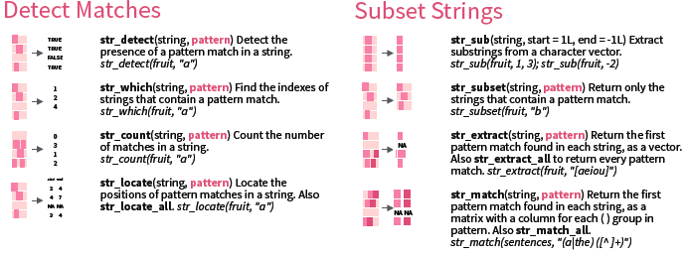
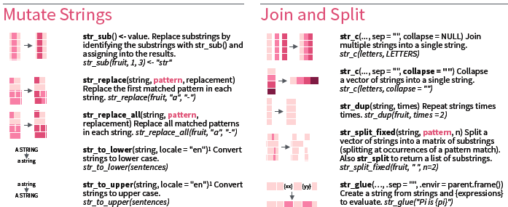
stringr: Manipulating strings
Learn more at: http://stringr.tidyverse.org

Slide 13
> library(stringr)
> x <- c("house", "car", "plant", "telephone", "arm chair")
> print(x)
[1] "house" "car" "plant" "telephone" "arm chair"
> # how many letters?
> str_length(x)
[1] 5 3 5 9 9
> # detecting characters
> str_detect(x, "ar")
[1] FALSE TRUE FALSE FALSE TRUE
> # which ones match?
> x[str_detect(x, "ar")]
[1] "car" "arm chair“
> # replacing characters
> str_replace(x, "ar", "**")
[1] "house" "c**" "plant" "telephone" "**m chair"
> x |> str_replace("ar", "**")
[1] "house" "c**" "plant" "telephone" "**m chair"
> # regular expressions: find vowels [aeiou]
> str_replace_all(x, "[aeiou]", "_")
[1] "h__s_" "c_r" "pl_nt" "t_l_ph_n_" "_rm ch__r"
Changing case
> str_to_upper(x)
[1] "HOUSE" "CAR" "PLANT" "TELEPHONE" "ARM CHAIR"
> str_to_sentence(x)
[1] "House" "Car" "Plant" "Telephone" "Arm chair"
> str_to_title(x)
[1] "House" "Car" "Plant" "Telephone" "Arm Chair"

Slide 14
glue: Interpolating strings
A common problem: Interpolating the values of variables into a text string.
glue does this by embedding R expressions in {curly braces} which are evaluated and inserted into the argument string.
glue is vectorized
library(glue)
name <- “Michael“; food <- “pizza”
glue('My name is {name}. I like {food}.')
#> My name is Michael. I like pizza.
> food <- c("pizza", "burgers")
> glue('My name is {name}. I like {food}.')
My name is Michael. I like pizza.
My name is Michael. I like burgers.
glue_data() is useful with pipes and data frames
head(mtcars,4) |>
glue_data("{rownames(.)} has {hp} hp & {cyl} cylinders")
#> Mazda RX4 has 110 hp & 6 cylinders
#> Mazda RX4 Wag has 110 hp & 6 cylinders
#> Datsun 710 has 93 hp & 4 cylinders
#> Hornet 4 Drive has 110 hp & 6 cylinders
NB: paste() is the base-R version. glue() is much more powerful

Slide 15
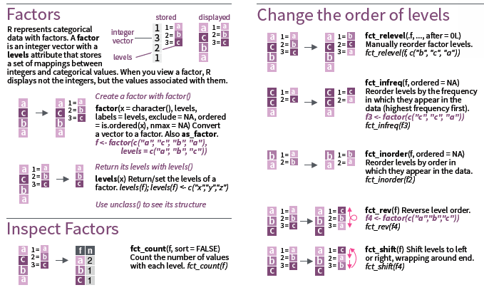
forcats: Working with factors
R represents categorical variables as factors, useful for analysis (e.g., ANOVA)
In graphics, we often want to recode levels or reorder them
Learn more at: http://forcats.tidyverse.org

Slide 16
> str(survey)
'data.frame': 200 obs. of 3 variables:
$ marital: Factor w/ 5 levels "divorced","married",..: 2 4 2 2 2 ...
$ party : Factor w/ 4 levels "Green","Lib",..: 3 4 2 2 4 ...
$ age : num 33.5 24 31 ...
# default: Alpha order
ggplot(survey, aes(x= party, fill = party)) +
geom_bar() + coord_flip()
# reorder by frequency
survey |> mutate(party=fct_i
nfreq(party)) |>
ggplot(aes(x= party, fill = party)) +
geom_bar() + coord_flip()
# reorder by right - left
survey |>
mutate(party = fct_relevel(party,
c("PC", "Lib",
"NDP", "Green"))) |>
ggplot(aes(x= party, fill = party)) +
geom_bar() + coord_flip()

Slide 17

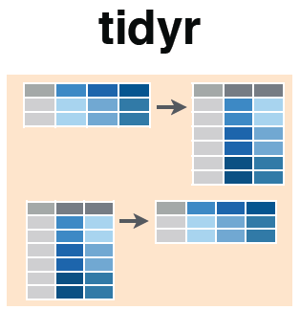
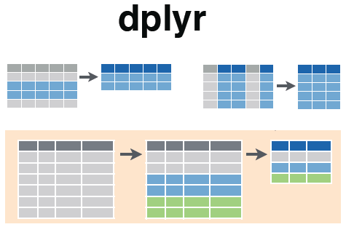


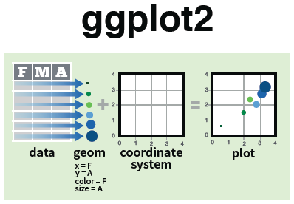

Tidy tools: overview
pipes
pivot_longer()
%>%
filter()
select()
pivot_wider()
Reshape data to be tidy
Manipulate & summarize tidy data
Visualize me!

Slide 18
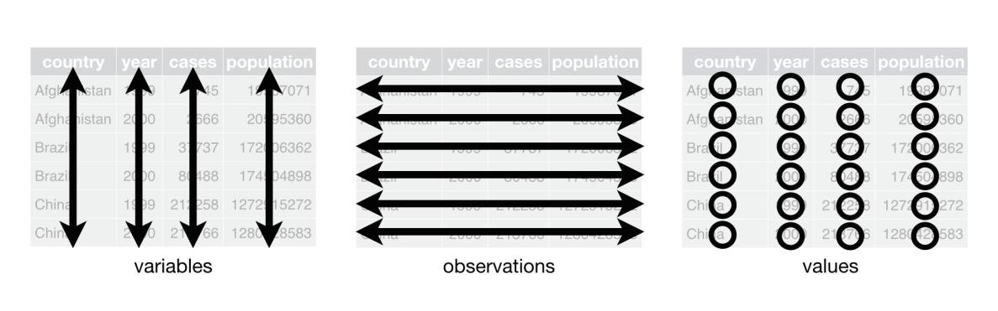
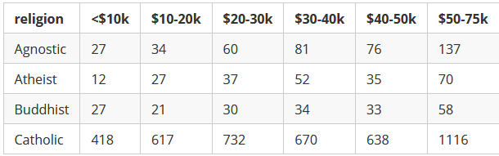
Data wrangling with dplyr & tidyr
What is Tidy Data?
A dataset is said to be tidy if:
observations are in rows
variables are in columns
each value is in its own cell.
A “messy” dataset: Survey of income by religion from Pew Research
Values of income are in separate columns, not one variable
Column headers are values, not variable names
Cell values are frequencies--- implicit, not explicit
This organization is easy in Excel
But, this makes data analysis and graphing hard

Slide 19
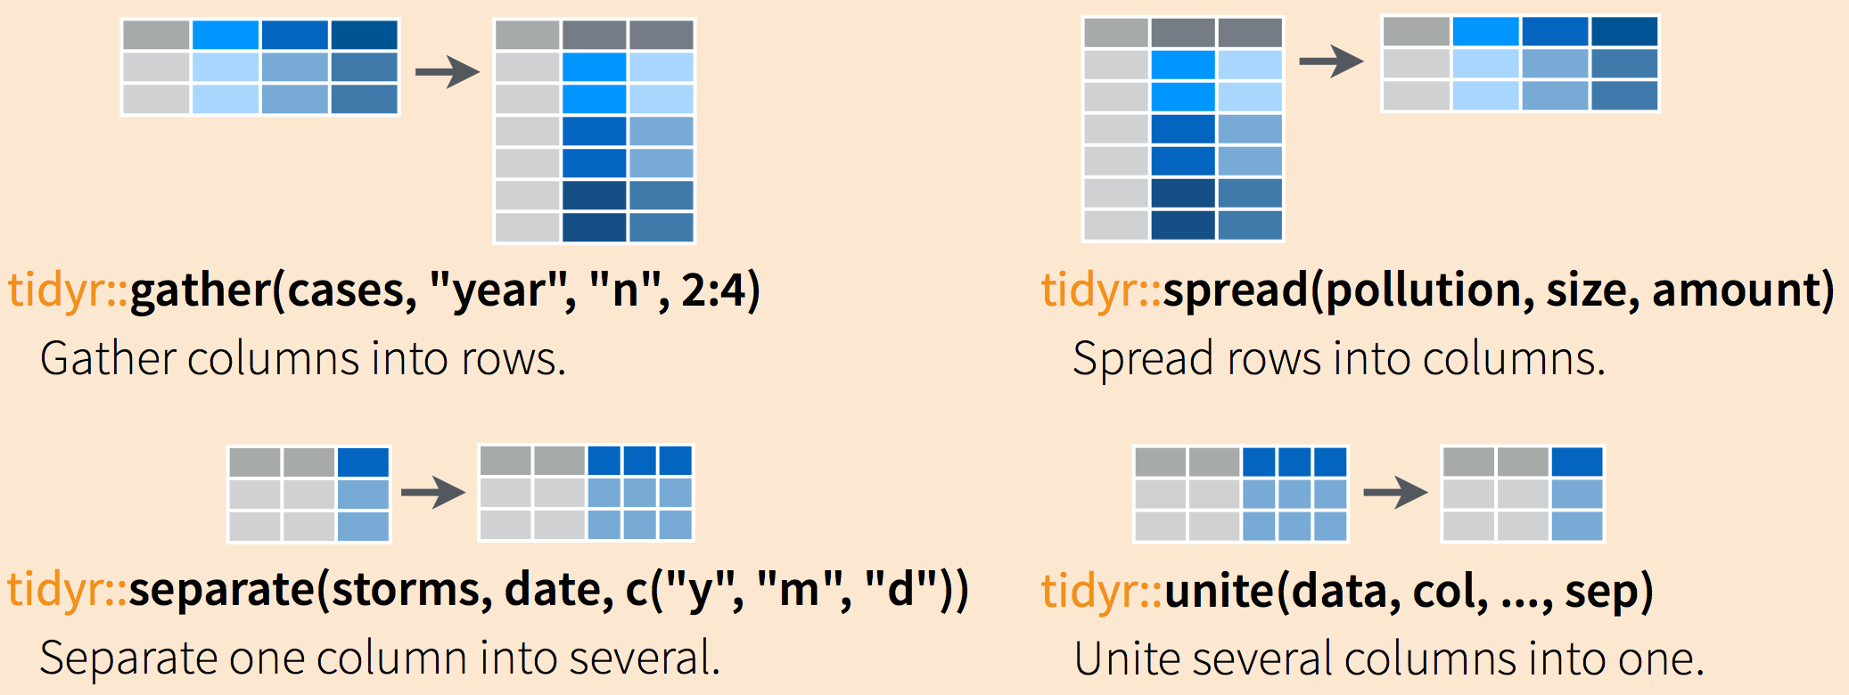
Tidy operations
gather(): Reshape wide to long
synonym: tidyr::pivot_longer()
spread(): Reshape long to wide
synonym: tidyr::pivot_longer()
Separate parts of a value into several variables
Join related variables into one

Slide 20
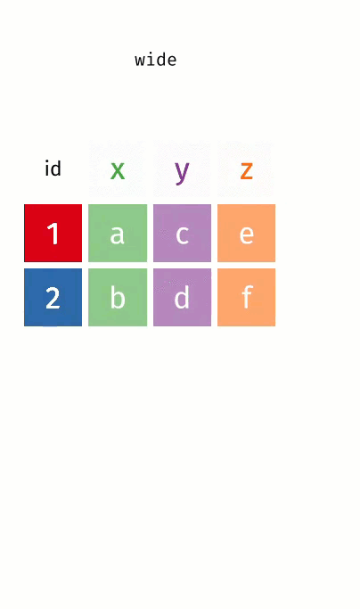
Wide → Long
pivot_longer(wide,
cols = x:z,
names_to = “key”,
values_to = “val”)
Long → Wide
pivot_wider(long,
names_from = key,
values_from = val)
Image from: https://www.garrickadenbuie.com/project/tidyexplain/

Slide 21
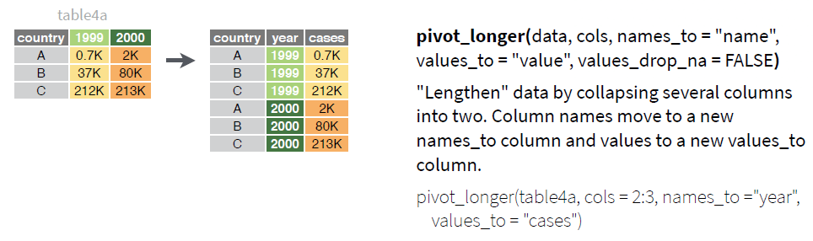
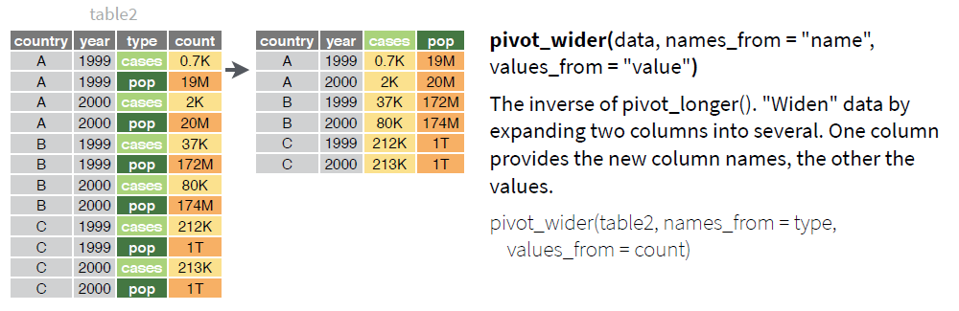
Reshaping data: Long ↔ Wide

Slide 22
Tidying: reshaping wide to long
We can tidy the data by reshaping from wide to long format using tidyr::gather() or pivot_longer()
> pew <- read.delim(
file = "http://stat405.had.co.nz/data/pew.txt",
header = TRUE,
stringsAsFactors = FALSE, check.names = FALSE)
> (pew1 <- pew[1:4, 1:6]) # small subset
religion <$10k $10-20k $20-30k $30-40k $40-50k
1 Agnostic 27 34 60 81 76
2 Atheist 12 27 37 52 35
3 Buddhist 27 21 30 34 33
4 Catholic 418 617 732 670 638
key
value
columns
>library(tidyr)
> gather(pew1, "income", "frequency", 2:6)
religion income frequency
1 Agnostic <$10k 27
2 Atheist <$10k 12
3 Buddhist <$10k 27
4 Catholic <$10k 418
5 Agnostic $10-20k 34
6 Atheist $10-20k 27
7 Buddhist $10-20k 21
8 Catholic $10-20k 617
9 Agnostic $20-30k 60
10 Atheist $20-30k 37
11 Buddhist $20-30k 30
12 Catholic $20-30k 732
13 Agnostic $30-40k 81
14 Atheist $30-40k 52
15 Buddhist $30-40k 34
16 Catholic $30-40k 670
… … … …
Another solution, using reshape2::melt()
> library(reshape2)
> pew_tidy <- melt(
data = pew1,
id = "religion",
variable.name = "income",
value.name = "frequency"
)
NB: income is a character variable; we might want to create an ordered factor or numeric version

Slide 23

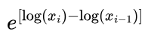
Using pipes: %>%, |>
R is a functional language
This means that f(x) returns a value, as in y <- f(x)
→ That value can be passed to another function: g(f(x))
→ And so on: h(g(f(x)))
E.g., calculate:
This gets messy and hard to read, unless you break it down step by step
> x <- c(0.109, 0.359, 0.63, 0.996, 0.515, 0.142)
> exp(diff(log(x)))
[1] 3.29 1.75 1.58 0.52 0.28
> # Compute the logarithm of `x`, calculate lagged differences,
> # return the exponential function of the result
> log(x)
[1] -2.216 -1.024 -0.462 -0.004 -0.664 -1.952
> diff(log(x)) #calculate lagged diffs
[1] 1.19 0.56 0.46 -0.66 -1.29
> exp(diff(log(x))) # convert back to original scale
[1] 3.29 1.75 1.58 0.52 0.28

Slide 24
Using pipes: %>%, |>
Pipes (|>) change the syntax to make this easier
Basic rules
x |> f() passes object on left hand side as first argument (or . argument) of function on right hand side
x |> f() is the same as f(x)
x |> f(y) is the same as f(x, y)
y %>% f(x, ., z) is the same as f(x, y, z)
x %<>% f()does the same, but assigns the result to x
Shortcut for x <- x %>% f()
> # use pipes
> x |> log() |> diff() |> exp()
[1] 3.29 1.75 1.58 0.52 0.28
NB: pipes (%>%) originally in magrittr pkg; native pipe (|>) introduced in R 4.1
Some things, like the “.” work only with %>%

Slide 25
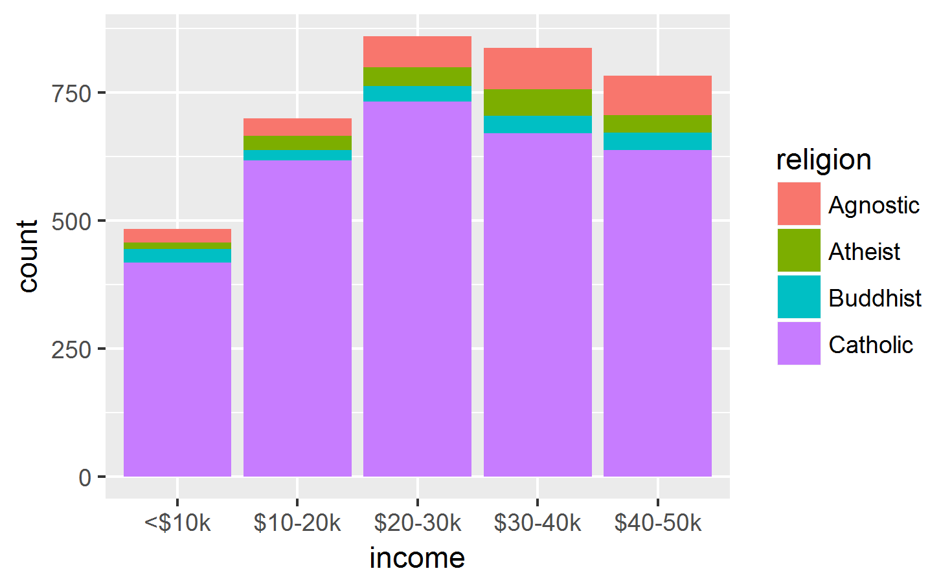
Using pipes: |> ggplot()
For the Pew data, mutate income → ordered factor and |> to ggplot
pew1 |>
gather("income", "frequency", 2:6) |> # reshape
mutate(income = ordered(income, levels=unique(income))) |> # make ordered
ggplot(aes(x=income, fill=religion)) + # plot
geom_bar(aes(weight=frequency)) # as freq bars
mutate() calculates or transforms column variables
ordered(income) levels are now ordered appropriately.
The result is piped to ggplot()

Slide 26
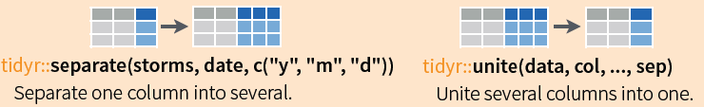
Tidying: separate() and unite()
It sometimes happens that several variables are crammed into one column, or parts of one variable are split across multiple columns
For example, for the pew data, we might want separate income into low & high
pew_long |>
mutate(inc = gsub("[\\$k]", "", income)) |>
mutate(inc = gsub("<", "0-", inc)) |>
separate(inc, c("low", "high"), "-") |>
head()
religion income frequency low high
1 Agnostic <$10k 27 0 10
2 Atheist <$10k 12 0 10
3 Buddhist <$10k 27 0 10
4 Catholic <$10k 418 0 10
5 Agnostic $10-20k 34 10 20
6 Atheist $10-20k 27 10 20
NB: tidyr::separate() now superceded by separate_wider_{delim, position}()

Slide 27
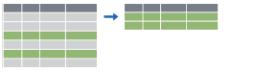

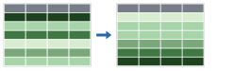
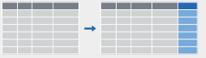

dplyr: verbs for manipulating data
verb | What it does
filter() | extract rows
select() | extract columns
arrange() | sort rows
mutate() | make new columns
group_by() |> summarize() | calculate group summaries

Slide 28
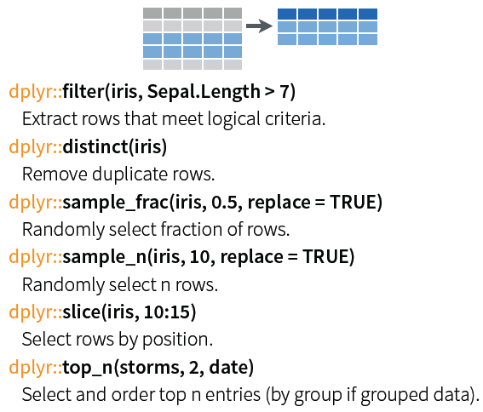
dplyr: Subset observations (rows)
dplyr implements a variety of verbs to select a subset of observations from a dataset
In a pipe expression, omit the dataset name
iris |> filter(Sepal.Length >7)
iris |> filter(Species==“setosa”)
iris |> sample_n(10)
iris |> slice(1:50) # setosa
iris |> group_by(Species) |>
slice_max(Sepal.Width, n=2)
After group_by() does operations w/in each group

Slide 29

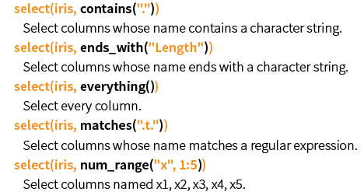
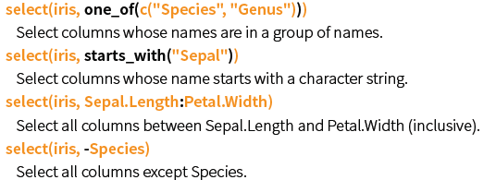
dplyr: Subset variables (columns)
Many helper functions in dplyr allow selection by a function of variable names:

Slide 30
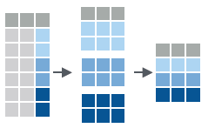

dplyr: group_by() and summarise()
Fundamental operations in data munging are:
grouping a dataset by one or more variables
calculating one or more summary measures
ungrouping: expand to an ungrouped copy, if needed
data
group
summarise
mtcars |>
group_by(cyl) |>
summarise(avg=mean(mpg))
data
avg
mtcars |>
group_by(cyl) |>
summarise(avg=mean(mpg)) |>
ungroup()

Slide 31

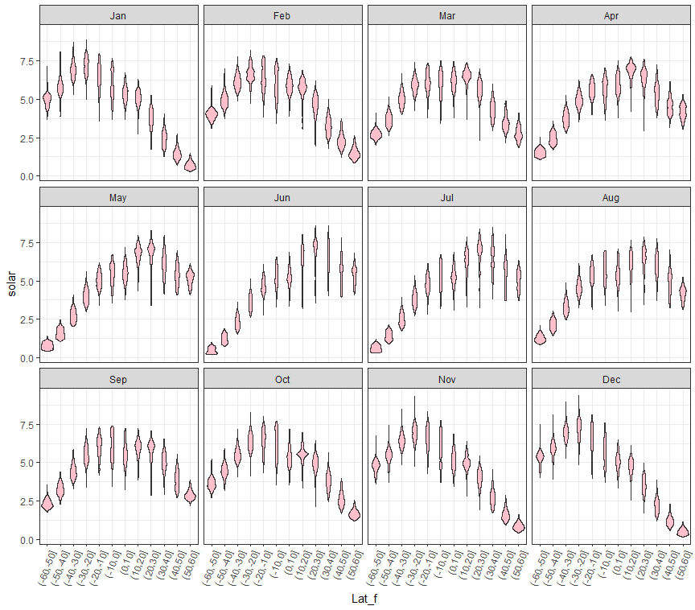
Example: NASA data on solar radiation
Months
How does solar radiation vary with latitude, over months of the year?
How to make this plot?
Q:
what are the basic plot elements?
Solar radiation
A:
x = Latitude, y= solar
geom_violin()
panels: month
Latitude

Slide 32
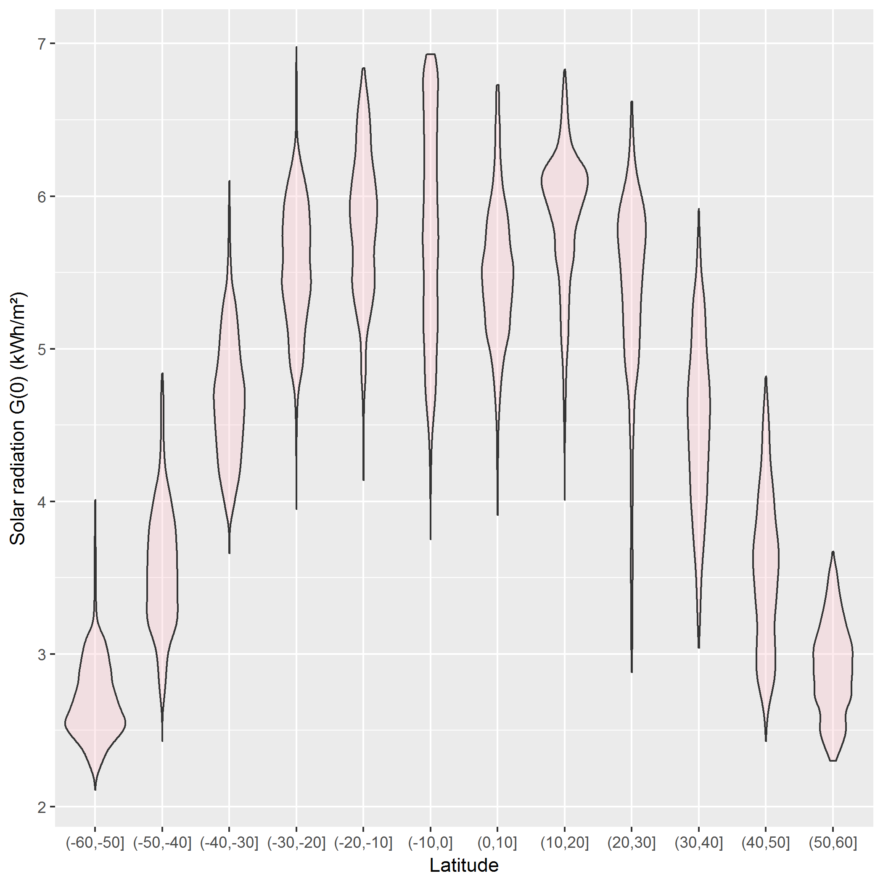
NASA data: solar radiation
This is easy to do for the total Annual solar radiation, a column in the data
> str(nasa)
'data.frame': 64800 obs. of 15 variables:
$ Lat: int -90 -90 -90 -90 -90 -90 -90 -90 -90 -90 ...
$ Lon: int -180 -179 -178 -177 -176 -175 -174 -173 -172 -171 ...
$ Jan: num 9.63 9.63 9.63 9.63 9.63 9.63 9.63 9.63 9.63 9.63 ...
$ Feb: num 5.28 5.28 5.28 5.28 5.28 5.28 5.28 5.28 5.28 5.28 ...
$ Mar: num 0.75 0.75 0.75 0.75 0.75 0.75 0.75 0.75 0.75 0.75 ...
$ Apr: num 0 0 0 0 0 0 0 0 0 0 ...
$ May: num 0 0 0 0 0 0 0 0 0 0 ...
$ Jun: num 0 0 0 0 0 0 0 0 0 0 ...
$ Jul: num 0 0 0 0 0 0 0 0 0 0 ...
$ Aug: num 0 0 0 0 0 0 0 0 0 0 ...
$ Sep: num 0.1 0.1 0.1 0.1 0.1 0.1 0.1 0.1 0.1 0.1 ...
$ Oct: num 3.24 3.24 3.24 3.24 3.24 3.24 3.24 3.24 3.24 3.24 ...
$ Nov: num 8.28 8.28 8.28 8.28 8.28 8.28 8.28 8.28 8.28 8.28 ...
$ Dec: num 11 11 11 11 11 ...
$ Ann: num 3.19 3.19 3.19 3.19 3.19 3.19 3.19 3.19 3.19 3.19 ...
nasa |>
filter(abs(Lat) < 60) |>
mutate(Latf = cut(Lat, pretty(Lat, n=12))) |>
ggplot(aes(x=Latf, y=Ann)) +
geom_violin(fill="pink", alpha=0.3) +
labs(x="Latitude", y="Solar radiation G(0) (kWh/m²)")
restrict latitude to [-60, 60]
bin Lat into ordered levels, using cut()
violin plot for each

Slide 33
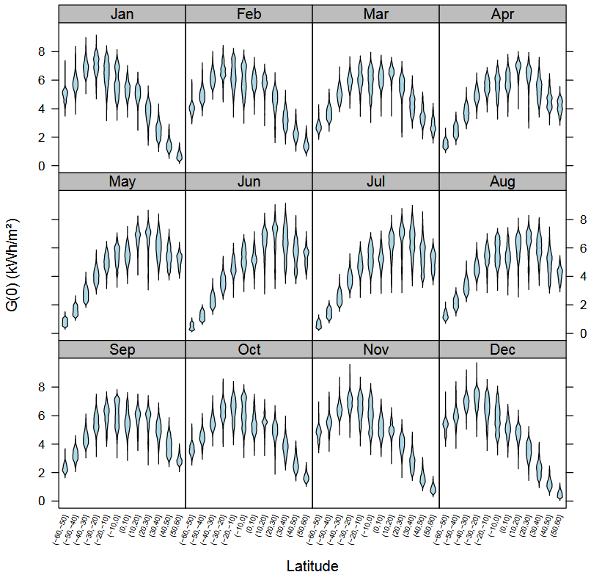
Faceting & tidy data
This is complicated to do for the separate months, because the data structure is untidy--- months were in separate variables (wide format)
> str(nasa)
'data.frame': 64800 obs. of 15 variables:
$ Lat: int -90 -90 -90 -90 -90 -90 -90 -90 -90 -90 ...
$ Lon: int -180 -179 -178 -177 -176 -175 -174 -173 -172 -171 ...
$ Jan: num 9.63 9.63 9.63 9.63 9.63 9.63 9.63 9.63 9.63 9.63 ...
$ Feb: num 5.28 5.28 5.28 5.28 5.28 5.28 5.28 5.28 5.28 5.28 ...
$ Mar: num 0.75 0.75 0.75 0.75 0.75 0.75 0.75 0.75 0.75 0.75 ...
$ Apr: num 0 0 0 0 0 0 0 0 0 0 ...
$ May: num 0 0 0 0 0 0 0 0 0 0 ...
$ Jun: num 0 0 0 0 0 0 0 0 0 0 ...
$ Jul: num 0 0 0 0 0 0 0 0 0 0 ...
$ Aug: num 0 0 0 0 0 0 0 0 0 0 ...
$ Sep: num 0.1 0.1 0.1 0.1 0.1 0.1 0.1 0.1 0.1 0.1 ...
$ Oct: num 3.24 3.24 3.24 3.24 3.24 3.24 3.24 3.24 3.24 3.24 ...
$ Nov: num 8.28 8.28 8.28 8.28 8.28 8.28 8.28 8.28 8.28 8.28 ...
$ Dec: num 11 11 11 11 11 ...
$ Ann: num 3.19 3.19 3.19 3.19 3.19 3.19 3.19 3.19 3.19 3.19 ...

Slide 34
tidying the data
To plot solar radiation against latitude by month (separate panels), we need to:
remove the Ann column
reshape the data for Jan:Dec to long format, so solar is all in one column
restrict latitude to [-60, 60]
bin Lat into ordered levels, using cut()
library(tidyr)
library(dplyr)
library(ggplot2)
nasa_long <- nasa |>
select(-Ann) |>
gather(month, solar, Jan:Dec, factor_key=TRUE) |>
filter( abs(Lat) < 60 ) |>
mutate( Lat_f = cut(Lat, pretty(Lat, 12)))
|> “pipes” data to the next stage
select() extracts or drops columns
gather() collapses columns into key-value pairs
filter() subsets observations
mutate() creates new variables

Slide 35
tidying the data
> str(nasa_long)
'data.frame': 514080 obs. of 5 variables:
$ Lat : int -59 -59 -59 -59 -59 -59 -59 -59 -59 -59 ...
$ Lon : int -180 -179 -178 -177 -176 -175 -174 -173 -172 -171 ...
$ month: Factor w/ 12 levels "Jan","Feb","Mar",..: 1 1 1 1 1 1 1 1 1 1 ...
$ solar: num 5.19 5.19 5.25 5.25 5.17 5.17 5.15 5.15 5.15 5.15 ...
$ Lat_f: Factor w/ 12 levels "(-60,-50]","(-50,-40]",..: 1 1 1 1 1 1 1 1 1 1 ...
> head(nasa_long)
Lat Lon month solar Lat_f
1 -59 -180 Jan 5.19 (-60,-50]
2 -59 -179 Jan 5.19 (-60,-50]
3 -59 -178 Jan 5.25 (-60,-50]
4 -59 -177 Jan 5.25 (-60,-50]
5 -59 -176 Jan 5.17 (-60,-50]
6 -59 -175 Jan 5.17 (-60,-50]
For ease of plotting, I created a factor version of Lat with 12 levels
The data are now in a form where I can plot solar against Lat or Lat_f and facet by month

Slide 36
plotting the tidy data
Using geom_violin() shows the shapes of the distributions for levels of Lat_f
ggplot(nasa_long, aes(x=Lat_f, y=solar)) +
geom_violin(fill="pink") +
facet_wrap(~ month) +
theme_bw() +
theme(axis.text.x =
element_text(angle = 70,
hjust = 1))
facet_wrap(~month) does the right thing: 12 months → 3×4 grid
I had to rotate the x-axis labels for Lat_f to avoid overplotting

Slide 37
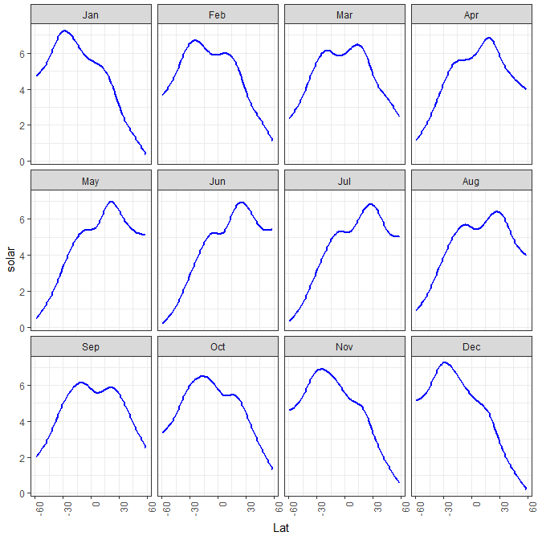
plotting the tidy data: smoothing
ggplot(nasa_long, aes(x=Lat, y=solar)) +
geom_smooth(color="blue" ) +
facet_wrap(~ month) +
theme_bw()
Here we treat Lat as quantitative.
geom_smooth() uses method = “gam” here because of large n
The variation in the smoothed trends over the year suggest quite lawful behavior, shifting over the year
Can we express this as a statistical model ?

Slide 38
Build a model
What we saw in the plot suggests a generalized additive model, with a smooth, s(Lat). Similar to loess in spirit, but this is a statistical model that can be tested.
library(mgcv)
nasa.gam <- gam(solar ~ Lon + month + s(Lat), data=nasa_long)
summary(nasa.gam)
Family: gaussian
Link function: identity
Formula:
solar ~ Lon + month + s(Lat)
Parametric coefficients:
Estimate Std. Error t value Pr(>|t|)
(Intercept) 4.691e+00 6.833e-03 686.409 < 2e-16 ***
Lon -1.713e-04 1.898e-05 -9.022 < 2e-16 ***
monthFeb 1.195e-01 9.664e-03 12.364 < 2e-16 ***
… …
monthDec -8.046e-02 9.664e-03 -8.326 < 2e-16 ***
---
Signif. codes: 0 ‘***’ 0.001 ‘**’ 0.01 ‘*’ 0.05 ‘.’ 0.1 ‘ ’ 1
The violin plots suggest that variance is not constant. I’m ignoring this here by using the default gaussian model.
Model terms:
Lon wasn’t included before
month is a factor, for the plots
s(Lat) fits a smoothed term in latitude, averaged over other factors
There are other model choices, but it is useful to visualize what we have done so far

Slide 39
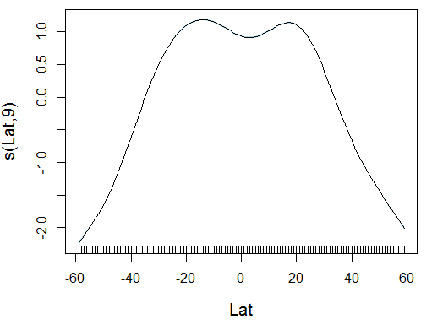
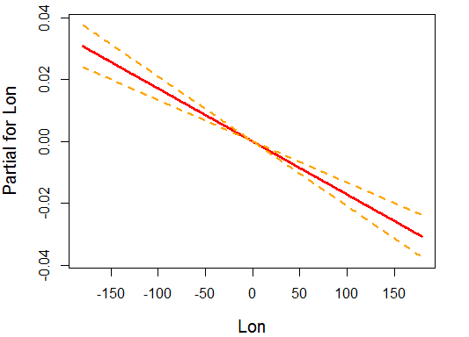
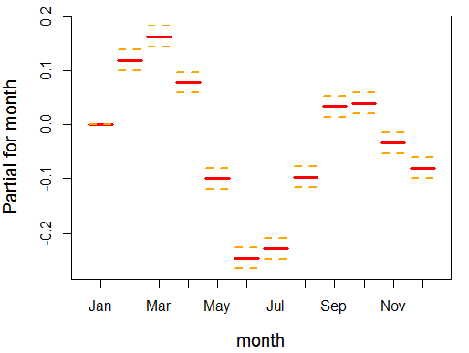
Visualize the model
Effect plots show the fitted relationship between the response and model terms, averaged over other predictors.
The {mgcv} package has its own versions of these: termplot()
plot(nasa.gam, cex.lab=1.25)
termplot(nasa.gam, terms="month", se=TRUE, lwd.term=3, lwd.se=2, cex.lab=1.25)
termplot(nasa.gam, terms="Lon", se=TRUE, lwd.term=3, lwd.se=2, cex.lab=1.25)
why the dip at the equator?
s(Lat, 9): gam used 9 df
effect of longitude is very small, but signif. & maybe interpretable
month should be modeled as a cyclic time variable

Slide 40
Visualizing models
R modeling functions [lm(), glm(), …] return model objects, but these are “messy”
extracting coefficients takes several steps: data.frame(coef(mymod))
some info (R², F, p.value) is computed in print() method, not stored
can’t easily combine models
Some have associated plotting functions
plot(model): diagnostic plots
car package: many model plot methods
effects package: plot effects for model terms
But what if you want to:
make a table of model summary statistics
fit a collection of models, compare, summarize or visualize them?

Slide 41

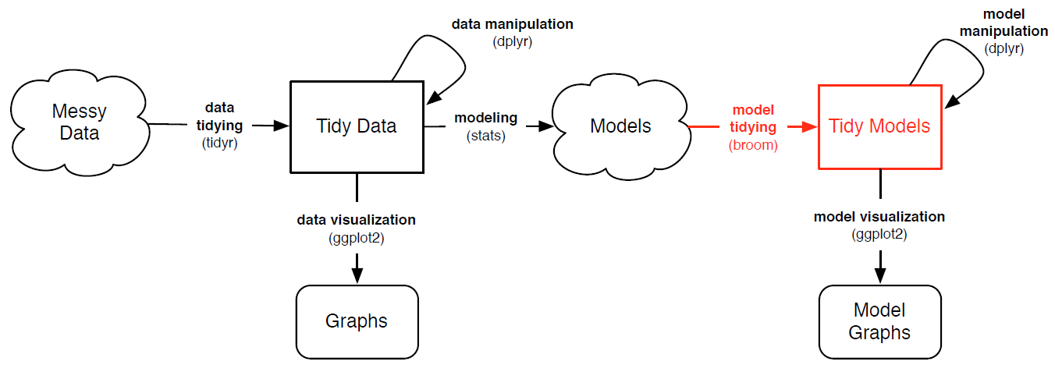
broom: manipulating models
The broom package turns model objects into tidy data frames
glance(models) extracts model-level summary statistics (R², df, AIC, BIC)
tidy(models) extracts coefficients, SE, p-values
augment(models) extracts observation-level info (residuals, …)
Image from: https://opr.princeton.edu/workshops/Downloads/2016Jan_BroomRobinson.pdf

Slide 42
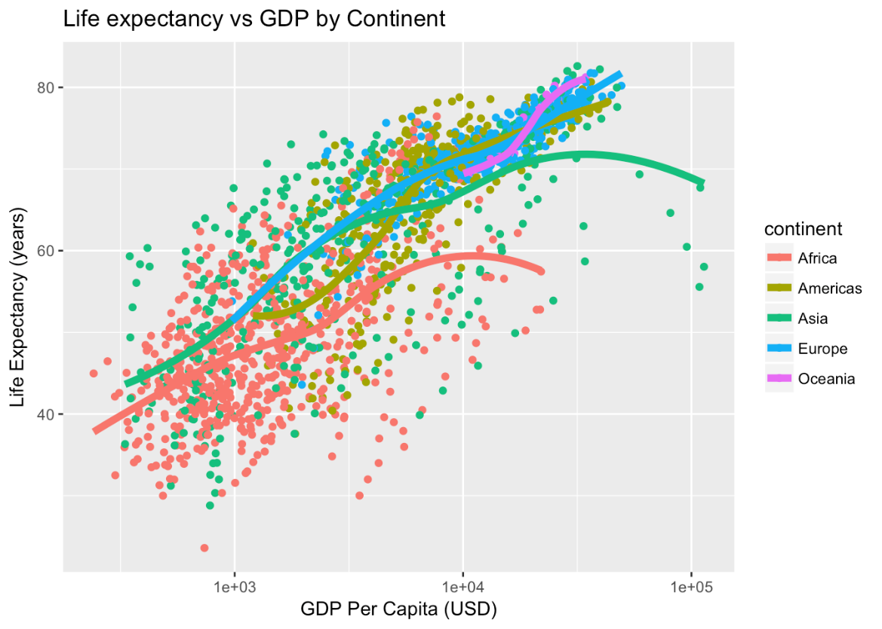
Example: gapminder data
ggplot(aes(x = log(gdpPercap), y=lifeExp, color=continent), data=gapminder) +
geom_point() +
geom_smooth(method = "loess")
How to model this?
How to extract & plot model statistics?
How to fit & display multiple models for subsets?

Slide 43
Example: gapminder data
Predict life expectancy from year, population, GDP and continent:
gapmod <- lm(lifeExp ~ year + pop + log(gdpPercap) + continent, data=gapminder)
summary(gapmod)
Call:
lm(formula = lifeExp ~ year + pop + log(gdpPercap) + continent, data = gapminder)
Residuals:
Min 1Q Median 3Q Max
-24.928 -3.285 0.314 3.699 15.221
Coefficients:
Estimate Std. Error t value Pr(>|t|)
(Intercept) -4.58e+02 1.67e+01 -27.43 < 2e-16 ***
year 2.38e-01 8.61e-03 27.58 < 2e-16 ***
pop 5.40e-09 1.38e-09 3.91 9.5e-05 ***
log(gdpPercap) 5.10e+00 1.60e-01 31.88 < 2e-16 ***
continentAmericas 8.74e+00 4.63e-01 18.86 < 2e-16 ***
continentAsia 6.64e+00 4.09e-01 16.22 < 2e-16 ***
continentEurope 1.23e+01 5.10e-01 24.11 < 2e-16 ***
continentOceania 1.26e+01 1.27e+00 9.88 < 2e-16 ***
---
Signif. codes: 0 ‘***’ 0.001 ‘**’ 0.01 ‘*’ 0.05 ‘.’ 0.1 ‘ ’ 1
Residual standard error: 5.79 on 1696 degrees of freedom
Multiple R-squared: 0.8, Adjusted R-squared: 0.799
F-statistic: 969 on 7 and 1696 DF, p-value: <2e-16
observation level
component level (coefficients)
model level

Slide 44
glance() gives the model level summary statistics
> glance(gapmod)
r.squared adj.r.squared sigma statistic p.value df logLik AIC BIC deviance df.residual
1 0.8 0.7992 5.789 969 0 8 -5406 10830 10879 56835 1696
tidy() gives the model component (term) statistics
> tidy(gapmod)
term estimate std.error statistic p.value
1 (Intercept) -4.585e+02 1.671e+01 -27.433 1.982e-137
2 year 2.376e-01 8.613e-03 27.584 1.122e-138
3 pop 5.403e-09 1.381e-09 3.912 9.496e-05
4 log(gdpPercap) 5.103e+00 1.601e-01 31.876 4.096e-175
5 continentAmericas 8.739e+00 4.635e-01 18.856 3.758e-72
6 continentAsia 6.635e+00 4.091e-01 16.219 4.167e-55
7 continentEurope 1.230e+01 5.102e-01 24.113 1.044e-110
8 continentOceania 1.256e+01 1.270e+00 9.884 1.943e-22
augment() gives the observation level statistics
> augment(gapmod) |> slice(1:5)
# A tibble: 5 x 12
lifeExp year pop log.gdpPercap. continent .fitted .se.fit .resid .hat .sigma
<dbl> <int> <int> <dbl> <fct> <dbl> <dbl> <dbl> <dbl> <dbl>
1 28.8 1952 8425333 6.66 Asia 46.0 0.408 -17.1 0.00496 5.78
2 30.3 1957 9240934 6.71 Asia 47.4 0.390 -17.1 0.00454 5.78
3 32.0 1962 10267083 6.75 Asia 48.8 0.376 -16.8 0.00423 5.78
4 34.0 1967 11537966 6.73 Asia 49.9 0.372 -15.9 0.00413 5.78
5 36.1 1972 13079460 6.61 Asia 50.5 0.382 -14.4 0.00435 5.78
# ... with 2 more variables: .cooksd <dbl>, .std.resid <dbl>

Slide 45
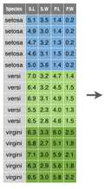
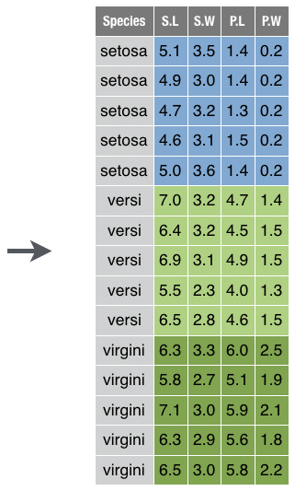
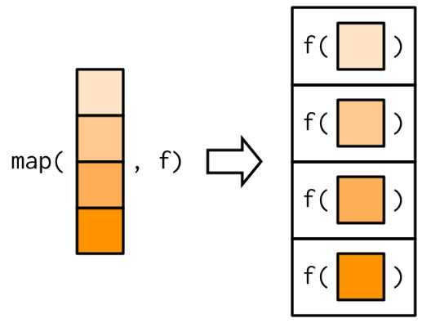
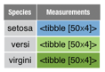
tidyr:: “nest – map – unnest” trick
In many cases, we want to perform analysis for each subset of a dataset defined by one or more variables
dplyr::group_by(), summarise(), ungroup() is one way
tidyr::nest(), purrr::map(), tidyr::unnest() is more general
nest
map
unnest
See: https://cran.r-project.org/web/packages/broom/vignettes/broom_and_dplyr.html

Slide 46

n_iris <- iris |> group_by(Species) |> nest() # group by Species, then nest
n_iris <- iris |> nest(-Species) # nest all other cols
setosa
virginica

Slide 47




purrr::map() & friends
A fundamental operation is doing something, f(), to each element of a vector, list, or column of a data.frame
map(1:3, log) ←→ list(log(1), log(2), log(3))
map(x, f) returns a list of f() applied to each of x
Other variants, map_{dbl, int, chr} return vectors
vector
list
map(df, mean)

Slide 48
Fitting multiple models
There may be different effects by continent ( GDP x continent interaction)
What if want to fit (and visualize) a separate model for each continent?
→ nest by continent, then {fit, tidy, glance, augment}
models <- gapminder |>
filter(continent != "Oceania") |> # only two countries
nest(data = -continent) |>
mutate(
fit = map(data, ~ lm(lifeExp ~ year + pop + log(gdpPercap), data = .x)),
tidied = map(fit, tidy),
glanced = map(fit, glance),
augmented = map(fit, augment)
)
What’s in this object?
names(models)
[1] "continent" "data" "fit" "tidied" "glanced" "augmented"

Slide 49
# view model summaries
models |>
select(continent, glanced) |>
unnest(glanced)
Model summary statistics
# A tibble: 4 x 13
continent r.squared adj.r.squared sigma statistic p.value df logLik AIC
<fct> <dbl> <dbl> <dbl> <dbl> <dbl> <dbl> <dbl> <dbl>
1 Asia 0.696 0.694 6.56 299. 5.27e-101 3 -1305. 2620.
2 Europe 0.797 0.795 2.46 466. 7.42e-123 3 -833. 1675.
3 Africa 0.500 0.498 6.48 207. 5.90e- 93 3 -2050. 4110.
4 Americas 0.720 0.718 4.97 254. 1.39e- 81 3 -904. 1819.
# ... with 4 more variables: BIC <dbl>, deviance <dbl>, df.residual <int>,
# model coefficients & tests
models |>
select(continent, tidied) |>
unnest(tidied)
Coefficients
# A tibble: 16 x 6
continent term estimate std.error statistic p.value
<fct> <chr> <dbl> <dbl> <dbl> <dbl>
1 Asia (Intercept) -6.20e+2 4.00e+1 -15.5 1.34e-42
2 Asia year 3.23e-1 2.06e-2 15.7 2.41e-43
3 Asia pop 5.13e-9 1.66e-9 3.09 2.15e- 3
4 Asia log(gdpPercap) 5.04e+0 2.76e-1 18.3 2.25e-54
5 Europe (Intercept) -1.72e+2 1.72e+1 -10.0 4.51e-21
# ...

Slide 50
Observations
# observation-level statistics
models |>
select(continent, augmented) |>
unnest(augmented)
# A tibble: 1,680 x 10
continent lifeExp year pop `log(gdpPercap)` .fitted .hat .sigma .cooksd
<fct> <dbl> <int> <int> <dbl> <dbl> <dbl> <dbl> <dbl>
1 Asia 28.8 1952 8425333 6.66 43.7 0.0101 6.53 0.0133
2 Asia 30.3 1957 9240934 6.71 45.6 0.00822 6.53 0.0113
3 Asia 32.0 1962 10267083 6.75 47.4 0.00685 6.53 0.00957
4 Asia 34.0 1967 11537966 6.73 48.9 0.00616 6.53 0.00805
5 Asia 36.1 1972 13079460 6.61 49.9 0.00645 6.54 0.00727
6 Asia 38.4 1977 14880372 6.67 51.9 0.00640 6.54 0.00678
7 Asia 39.9 1982 12881816 6.89 54.6 0.00607 6.53 0.00771
8 Asia 40.8 1987 13867957 6.75 55.5 0.00795 6.53 0.0101
9 Asia 41.7 1992 16317921 6.48 55.8 0.0114 6.53 0.0134
10 Asia 41.8 1997 22227415 6.45 57.3 0.0138 6.53 0.0198
# ... with 1,670 more rows, and 1 more variable: .std.resid <dbl>
y
ŷ
predictors
diagnostics

Slide 51

Visualizing multiple models
One visual summary might be a plot of R² values, ordered by continent
models |>
select(continent, glanced) |> unnest(glanced) |>
ggplot(aes(r.squared, reorder(continent, r.squared))) +
geom_point(size=4) +
geom_segment(aes(xend = 0, yend = ..y..)) +
ylab("Continent")

Slide 52

Visualizing coefficients
Coefficient plots are often useful, but these are on different scales.
models |> select(continent, tidied) |> unnest(tidied) # get model stats
filter(term != "(Intercept)") |> # ignore the intercept
mutate(term=factor(term, levels=c("log(gdpPercap)", "year", "pop"))) |> # reorder terms sensibly
ggplot(aes(x=term, y=statistic, color=continent, group=continent)) +
geom_point(size=5, alpha=0.5) +
geom_line(size=1.5) +
geom_hline(yintercept=c(-2, 0, 2), color = c("red", "black", "red")) + # hlines for non-significance
ylab("t statistic") +
theme_minimal() + theme(legend.position=c(0.9, 0.8))
Here, I plot the t-statistics, t=b_{ij}/se(b_{ij}) for all terms in all models.
Any values outside ~ ±2 are significant, p < 0.5!

Slide 53

Visualizing model fits
models |> select(continent, augmented) |> unnest(augmented) |>
ggplot(aes(x=`log(gdpPercap)`, y=.fitted, color=continent, fill=continent)) +
geom_point(size = 0.8, alpha=0.5) +
geom_smooth(method = "lm", alpha=0.5) +
ylab("Fitted Life Expectancy")
The slope for the Americas is noticeably larger than for other continents

Slide 54
Nice tables in R
Not a ggplot topic, but it is useful to know how you can produce beautiful tables in R
There are many packages for this: See the CRAN Task View on Reproducible Research
xtable: Exports tables to LaTeX or HTML, with lots of control
gt: the ggplot of tables!
flextable: similar to gt, but with themes
stargazer: Well-formatted model summary tables, side-by-side
apaStyle: Generate APA Tables for MS Word
tinytable: Simple yet powerful tables for HTML, LaTeX, Word, Markdown

Slide 55


Tables in R: xtable
Just a few examples, stolen from xtable: vignette(“xtableGallery.pdf”)
Too many decimals are used here, but you can control all that

Slide 56

Tables with {gt}
The {gt} package aims to provide a grammar of tables just as ggplot2 does for graphs
Designed to be simple to use, yet powerful
iris |> gt()

Slide 57

{gt} workflow
Data table -> gt_tbl object
iris |> gt() |>
tab_header(…) |>
tab_options(…) |> gtsave()
See: https://gt.rstudio.com/

Slide 58

iris_tab <-
iris |>
slice(1:5) |>
gt() |>
tab_header(
title = "Anderson's Iris Data",
subtitle = "(Collected in …)")
Sample 5 rows
pipe to gt()
add header

Slide 59

iris_tab <-
iris |>
slice(1:5) |>
gt() |>
tab_header(
title = "Anderson's Iris Data",
subtitle = "(Collected in …)")
iris_tab <-
iris_tab |>
tab_spanner(
label = "Sepal",
columns = c(Sepal.Length,
Sepal.Width)) |>
tab_spanner(
label = "Petal",
columns = c(Petal.Length,
Petal.Width)) |>
Add table column spanning headers

Slide 60

iris_tab <-
iris |>
slice(1:5) |>
gt() |>
tab_header(
title = "Anderson's Iris Data",
subtitle = "(Collected in …)")
iris_tab <- iris_tab |>
cols_label(
Sepal.Length = "Length",
Sepal.Width = "Width",
Petal.Length = "Length",
Petal.Width = "Width") |>
tab_options(
heading.background.color = "#c6dbef",
column_labels.background.color = "#edf8fb")
Re-label columns
Colorize headings
iris_tab <-
iris_tab |>
tab_spanner(
label = "Sepal",
columns = c(Sepal.Length,
Sepal.Width)) |>
tab_spanner(
label = "Petal",
columns = c(Petal.Length,
Petal.Width)) |>

Slide 61


tinytable
tinytable is a lightweight but full-featured table generator
simple interface, easy to learn
flexible output for all formats
library(tinytable)
x <- mtcars[1:5, 1:5]
tt(x)
See: https://vincentarelbundock.github.io/tinytable/

Slide 62
tinytable
A few simple functions for constructing nice tables:
data |> tt() |> # basic table
format_tt() |> # format columns: significant digits, decimal points, …
style_tt() |> # align, colors, …
theme_tt() |> # themes for LaTeX, HTML, …
group_tt() # spanning labels for groups of rows/ columns
save_tt(x, filename) # save to .docx, .html, .png, .pdf, .tex, or render in Rmarkdown

Slide 63



Writing & publishing
A variety of R packages make it easy to write and publish research reports, slide presentations in various formats (HTML, Word, LaTeX, …), all within R Studio
Write R scripts or documents comprising reproducible code and text
Special format for books, blogs, websites, …
Organize your work with:
R Studio projects
Github for version control & collaboration
Publish online with github-pages, Netlify, …

Slide 64



R Studio projects
R Studio projects are a handy way to organize your work
The .Rproj item opens the project in R Studio

Slide 65

R Studio projects
An R Studio project for a research paper: R files (scripts), Rmd files (text, R “chunks”)

Slide 66


Organizing an R project
Use a separate folder for each project
Use sub-folders for various parts
data files:
raw data (.csv)
saved R data (.Rdata)
figures:
diagrams
analysis plots
R files:
data import
analysis
Write up files will go here (.Rmd, .docx, .pdf)
This project, saved in a Dropbox folder automatically syncs with all my computers & collaborators. I use Git & GitHub for more serious work.

Slide 67
Organizing an R project
Use separate R files for different steps:
Data import, data cleaning, … → save as an RData file
Analysis: load RData, …
read-mydata.R
# read the data; better yet: use RStudio File -> Import Dataset ...
mydata <- read.csv("data/mydata.csv")
# data cleaning:
# filter missing, make factors, transform variables, ....
# save the current state
save("data/mydata.RData")

Slide 68
Organizing an R project
Use separate R files for different steps:
Data import, data cleaning, … → save as an RData file
Analysis: load RData, …
analyse.R
#’ ## load the data
load("data/mydata.RData")
#’ ## do the analysis – exploratory plots
plot(mydata)
#’ ## fit models
mymod.1 <- lm(y ~ X1 + X2 + X3, data=mydata)
#’ ## plot models, extract model summaries
plot(mymod.1)
summary(mymod.1)
NB: #’ ## is a special R comment for a H2 heading in an R “notebook” script

Slide 69


Reproducible analysis & reporting
R Studio, together with the knitr and rmarkdown packages provide an easy way to combine writing, analysis, and R output into complete documents
.Rmd files are just text files, using rmarkdown markup and knitr to run R on “code chunks”
A given document can be rendered in different output formats:

Slide 70



Output formats and templates
The integration of R, R Studio, knitr, rmarkdown and other tools is now highly advanced.
My 2nd last book was written entirely in R Studio, using .Rnw syntax → LaTeX → PDF → camera ready copy
The ggplot2 book was written using .Rmd format.
The bookdown package makes it easier to manage a book-length project – TOC, fig/table #s, cross-references, etc.
Also: blogdown, posterdown, …
Templates are available for APA papers, slides, handouts, entire web sites, etc.

Slide 71


Writing it up
In R Studio, create a .Rmd file to use R Markdown for your write-up
lots of options: HTML, Word, PDF (needs LaTeX)
templates for various pub types

Slide 72


Writing it up
Use simple Markdown to write text
Include code chunks for analysis & graphs
mypaper.Rmd, created from a template
Help -> Markdown quick reference
yaml header
Header 2
output code chunk
plot code chunk

Slide 73

Rmarkdown basics
Rmarkdown uses simple formatting for all standard document elements

Slide 74

R code chunks
R code chunks are run by knitr, and the results are inserted in the output document
There are many options for controlling the details of chunk output – numbers, tables, graphs
Choose the output format:
An R chunk:
```{r name, options}
# R code here
```

Slide 75

The R Markdown Cheat Sheet provides most of the details
https://www.rstudio.com/wp-content/uploads/2016/03/rmarkdown-cheatsheet-2.0.pdf

Slide 76



R notebooks
Often, you just want to “compile” an R script, and get the output embedded in the result, in HTML, Word, or PDF. Just type Ctrl-Shift-K or tap the Compile Report button
#’ Document title
### header
use $math$

Slide 77


Posters with posterdown
File → New file → R markdown…
YAML header:
---
title: My Awesome Poster
author:
- name: Michael Friendly
affil: 1
orcid: '0000-0002-3237-0941'
affiliation:
- num: 1
address: Psychology Dept, York University
column_numbers: 3
logoright_name: psy6135-hex.png
logoleft_name: psy6135-hex.png
output:
posterdown::posterdown_html:
self_contained: false
bibliography: packages.bib
---
Render: rmarkdown::render(“MyAwesomePoster.Rmd")
Wiki: https://github.com/brentthorne/posterdown/wiki

Slide 78


Slide 79


Slide 80

Summary
tidyverse thinking
data import → clean → make tidy
often need to reshape, wide ↔ long
tools for dates, factors, strings
Models:
broom to extract tidy results
nest – map trick to fit/plot multiple models
Writing it up
Learn to use table tools
Use Rstudio projects
Learn to use reproducible reporting (.Rmd)

Slide 81

ggplot extensions
There are a large number of ggplot extensions. See: http://www.ggplot2-exts.org/

Slide 82

ggplot extensions - book
New book by Antti Rask: https://ggplot2-extended-book.com/

Slide 83

ggplot extensions: GGally
GGally contains a large number of functions that extend ggplot2 to multivariate data
ggpairs() produces generalized scatterplot matrices, with lots of options
library(GGally)
library(dplyr)
library(ggplot2)
library(gapminder)
gapminder |>
select(-country, -year) |>
ggpairs(aes(color=continent))

Slide 84

ggplot extensions: ggrepel
devtools::install_github("slowkow/ggrepel")
library(ggplot2)
library(ggrepel)
ggplot(mtcars, aes(wt, mpg)) +
geom_point(color = 'red') +
geom_text_repel(aes(label = rownames(mtcars))) +
theme_classic(base_size = 16)
Plotting text labels is often difficult
ggrepel provides geoms for ggplot2 to repel overlapping text labels.

Slide 85

ggplot extensions: gganimate
gganimate is a wrapper for the animation package with ggplot2.
It adds a frame= aesthetic, and animates the image as the frame variable changes
p5 <- ggplot(gapminder, aes(gdpPercap, lifeExp, size = pop, frame = year)) +
geom_point() +
geom_smooth(aes(group = year), method = "lm", show.legend = FALSE) +
facet_wrap(~continent, scales = "free") +
scale_x_log10()
gganimate(p5)

Slide 86

ggpubr
The ggpubr package provides some easy-to-use functions for creating and customizing publication ready plots.
ggviolin(df, x = "dose", y = "len", fill = "dose",
palette = c("#00AFBB", "#E7B800", "#FC4E07"),
add = "boxplot", add.params = list(fill = "white")) +
stat_compare_means(comparisons = my_comparisons, label = "p.signif") +
stat_compare_means(label.y = 50)
see the examples at http://www.sthda.com/english/rpkgs/ggpubr/

Slide 87



ggseg: plotting brain atlases

Slide 88



ggthemes
+ theme_economist()
ggthemes provides a large number of extra geoms, scales, and themes for ggplot
install.packages('ggthemes', dependencies = TRUE)
+ theme_tufte()
+ theme_fivethirtyeight()

Slide 89

map(df, mean)
nest
map
unnest

